Slide 1
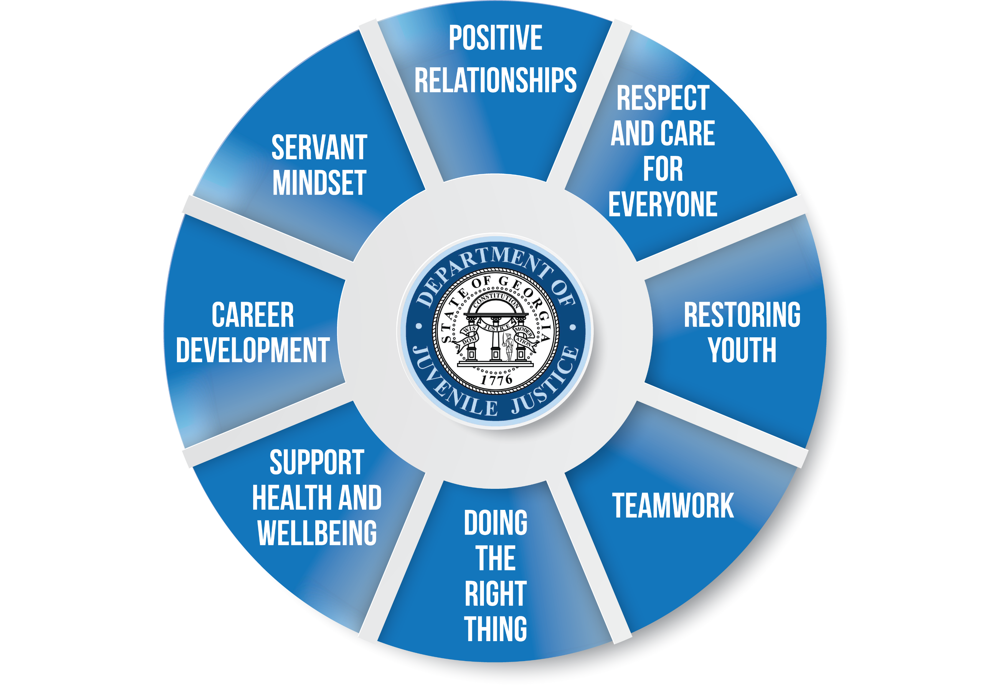
OUR CULTURE
AT GEORGIA DEPARTMENT OF JUVENILE JUSTICE

Slide 2
POSITIVE RELATIONSHIPS
Forming relationships with colleagues
that enhance our mental and emotional wellbeing, making our jobs more enjoyable.

Slide 3
RESPECT AND CARE FOR EVERYONE
When our actions align with our words through consideration and compassion, we exhibit respect for one another.

Slide 4
RESTORING YOUTH
Restoring our youth by strengthening their wellbeing and providing high-quality education and essential services in a supervised rehabilitative environment.

Slide 5
TEAMWORK
Building and developing a team that can help get the work done.

Slide 6
DOING THE RIGHT THING
Sustaining an effective organization value system allowing us to maintain our integrity and principles over popular decisions.

Slide 7
SUPPORT HEALTH AND WELLBEING
Providing employees with resources to promote their emotional, financial, spiritual, physical, mental, and occupational health.

Slide 8
CAREER DEVELOPMENT
Investing in how our employees manage their careers ensures they have the training and skills to progress in their chosen paths.

Slide 9
SERVANT MINDSET
Fostering an environment that allows personnel to focus on their team members’ needs before considering their own, leading to stronger relationships with team members and other stakeholders.

